Slide 1
IDENTITY VERIFICATION & DEFENSE
Securing Digital KYC in the Deepfake Era
From automated onboarding to neural puppetry and next-gen hardware attestation.

Slide 2

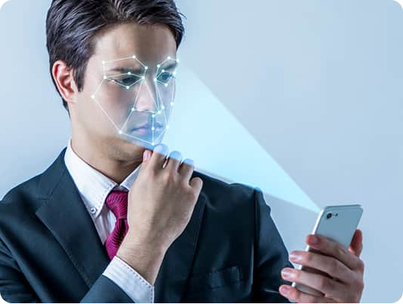
DIGITAL TRANSFORMATION
The Evolution of Identity Proofing
Zero-Friction Access
Remote onboarding replaces in-person banking counters.
Strict Accountability
Prevents money laundering and synthetic spoofing.
Forensic Audit Trail
Verifiable evidence chains for incident tracing.

Slide 3


DEFENSE ARCHITECTURE
Traditional 3-Tier Security Architecture
Document Check
Face Matching
Liveness Detection
Government database cross-referencing.
Biometric facial landmark alignment.
Dynamic eye-blink and head-turn prompts.

Slide 4

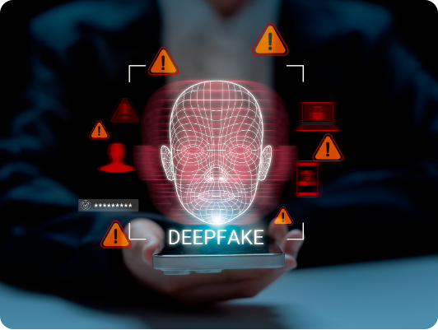
EMERGING THREAT VECTOR
Cracks in the Shield: Generative AI
Generative AI has shattered the assumption that video streams guarantee human authenticity.
Synthetic Identities: Photorealistic faces generated from scratch.
Motion Fluidity: Responsive real-time facial puppetry.
Automated Bypass: Static and dynamic challenge-response defeat.

Slide 5
ATTACK TAXONOMY
Primary Deepfake Attack Vectors
Neural Puppetry
Virtual Camera Hijacking
Real-Time Face Replacement
Direct Pipeline Video Injection
Target Mapping: Impostor mimics victim head movements.
Bypassed Lens: Physical camera hardware disabled completely.
Instant Liveness Pass: System sees expected rotations.
Human Proctor Trick: Visual inspection fails at distance.
Emulator Stream: Pre-rendered video pushed into driver layer.
Stream Spoofing: App receives synthetic movie output.

Slide 6

ACTIVE COUNTERMEASURES
Defense 1: Photometric Screen Strobing
Unpredictable Lighting Sequences
Pre-rendered deepfakes cannot anticipate future color sequences.
Physics Defeats Pre-Rendering
Sub-Surface Scattering Check
Biological skin absorption properties verified instantly.
Randomized RGB screen flashes reflect off human skin contours in microsecond intervals.
Immediate Stream Rejection
Mismatched skin absorption terminates verification session.

Slide 7


HARDWARE LAYER DEFENSE
Defense 2: Cryptographic Sensor Attestation
Silicon Roots
Signed Frames
Emulator Kill
Direct queries to Apple Secure Enclave & Android StrongBox.
Cryptographic proof raw sensor captured the feed milliseconds ago.
Virtual camera drivers and injection hooks disconnect on trigger.

Slide 8
CREDENTIAL VERIFICATION
Defense 3: Direct NFC Chip Interrogation
Eliminating Document Photo Manipulation
RFID Contactless Read
User taps national ID/passport against phone antenna.
Optical card scanning is easily fooled by Photoshop. Reading embedded cryptographic chips guarantees sovereign authenticity.
Tamper-Proof Extraction
High-resolution source photo extracted directly from chip.
Zero Image Alteration
ICAO 9303
Signed Biometrics
Cannot be altered via image editing software.
Global passport standard.
Encrypted state certificates.

Slide 9
PLATFORM PARITY
Securing Desktop & Web Browsers
Mobile Handoff
FFT Frequency Check
Human Proctoring
Routes desktop users to phone cameras via secure QR code.
Fast Fourier Transforms flag synthetic generative pixel artifacts.
Contextual questions and physical document cheek alignment.

Slide 10
UNIFIED DEFENSE
Modern Multi-Modal Verification Flow
1
2
3
4
Hardware Audit
NFC Read
Color Strobe
FFT Analysis
Validates Secure Enclave.
Extracts signed sovereign photo.
Tests photometric skin reflex.
Scans frame artifacts.

Slide 11
STRATEGIC SUMMARY
Defense In Depth Metrics
3-Tier
0%
100%
Hardware + Physics + Math
Driver Bypass Tolerance
Cryptographic Integrity
Layered anti-spoofing defense.
Secured hardware sensor feeds.
Immutable NFC chip certificates.

Slide 12


INSTITUTIONAL IMPLEMENTATION
Overview of KYC at J.P. Morgan
Mandatory Attributes
Core KYC Workflow
Client Services
Name, PAN, Address, Mobile, Email ID, and Income Range.
CIP, MDD, CDD, EDD, Sanction lists, and PEP screening.
Corporate and institutional account opening operations.
J.P. Morgan KYC Compliance Advisory
Global AML Compliance Program
Dedicated Operations Teams

Slide 13

Identity Defense Must Evolve with AI
Physics-based challenge-response and chip-level cryptography ensure identity verification stays ahead of synthetic deception.

Slide 14


Image Sources
https://content.kaspersky-labs.com/se/com/content/en-global/images/repository/isc/48-Biometrics/48-Biometrics.jpg
Source: www.kaspersky.com
https://www.derebus.org.za/wp-content/uploads/2026/03/Ndobeni.jpg
Source: www.derebus.org.za

